Slide 1
Data Science
Graphical Displays
Box Plot
Lecture No. 3b

Slide 2
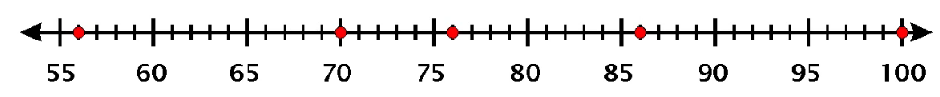
Box and Whisker Plot (aka Boxplot)
Boxplot is helpful in a lot of ways!
An extreme value that is at abnormal distance from other values.
Can be used to find Outliers!
IQR
What distance is abnormal?
What is an outlier?
MIN
Q1
Median
Q3
MAX

Slide 3



Outlier Detection with IQR
IQR
MIN
Q1
Median
Q3
MAX
Useful Article: https://www.thoughtco.com/what-is-the-interquartile-range-rule-3126244

Slide 4
Drawing a Box Plot.
Example 1: Draw a Box plot for the data below
Q₁
Q₂
Q₃
4, 4, 5, 6, 8, 8, 8, 9, 9, 9, 10, 12
Lower Quartile = 5½
Upper Quartile = 9
Median = 8

Slide 5
Drawing a Box Plot.
Example 1: Draw a Box plot for the data below
Q₁
Q₂
Q₃
4, 4, 5, 6, 8, 8, 8, 9, 9, 9, 10, 12
Lower Quartile = 5½
Upper Quartile = 9
Median = 8
4
5
6
7
8
9
10
11
12

Slide 6
Drawing a Box Plot.
Example 2: Draw a Box plot for the data below
Q₁
Q₂
Q₃
3, 4, 4, 6, 8, 8, 8, 9, 10, 10, 15,
Lower Quartile = 4
Upper Quartile = 10
Median = 8
3
4
5
6
7
8
9
10
11
12
13
14
15

Slide 7
Drawing a Box Plot.
Question: Stuart recorded the heights in cm of boys in his class as shown below. Draw a box plot for this data.
Q_{L}
Q₂
Q_{u}
137, 148, 155, 158, 165, 166, 166, 171, 171, 173, 175, 180, 184, 186, 186
Lower Quartile = 158
Upper Quartile = 180
Median = 171
130
140
150
160
170
180
cm
190

Slide 8
Drawing a Box Plot.
Question: Gemma recorded the heights in cm of girls in the same class and constructed a box plot from the data. The box plots for both boys and girls are shown below. Use the box plots to choose some correct statements comparing heights of boys and girls in the class. Justify your answers.
Boys
130
140
150
160
170
180
cm
190
Girls
1. The girls are taller on average.
2. The boys are taller on average.
3. The girls show less variability in height.
5. The smallest person is a girl.
4. The boys show less variability in height.
6. The tallest person is a boy.
Notes:
iqr > show greter variblity < shoe les

Slide 9
Box Plot Example
18, 34, 76, 29, 15, 41, 46, 25, 54, 38, 20, 32, 43, 22

Slide 10
Worksheet 1
worksheet
Finding the median, quartiles and inter-quartile range.
Finding the median, quartiles and inter-quartile range.
Example 1: Find the median and quartiles for the data below.
12, 6, 4, 9, 8, 4, 9, 8, 5, 9, 8, 10
Example 2: Find the median and quartiles for the data below.
6, 3, 9, 8, 4, 10, 8, 4, 15, 8, 10

Slide 11
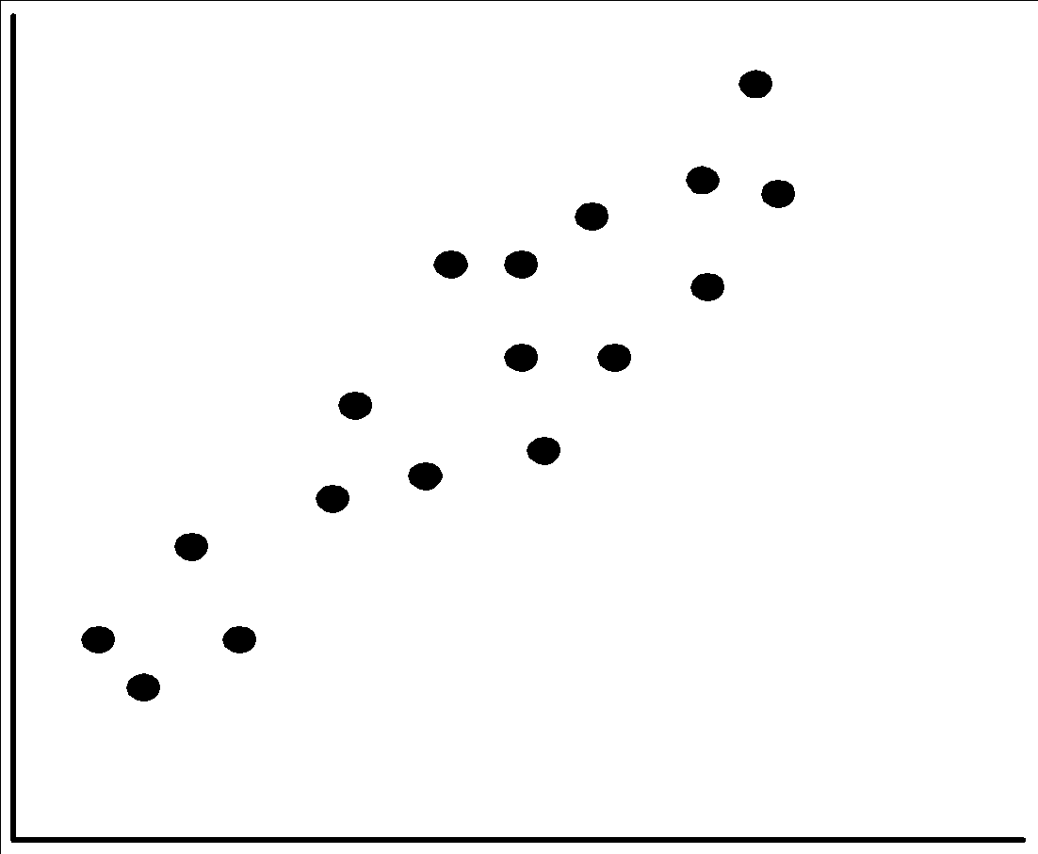
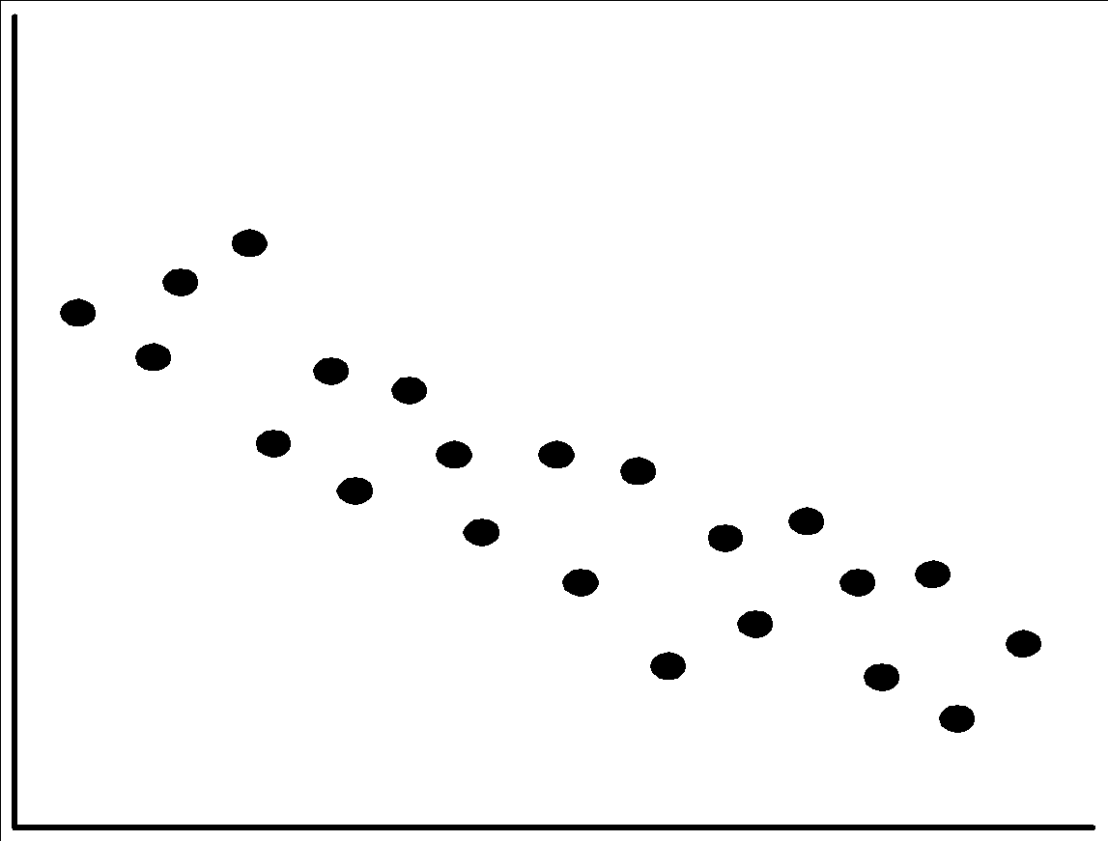
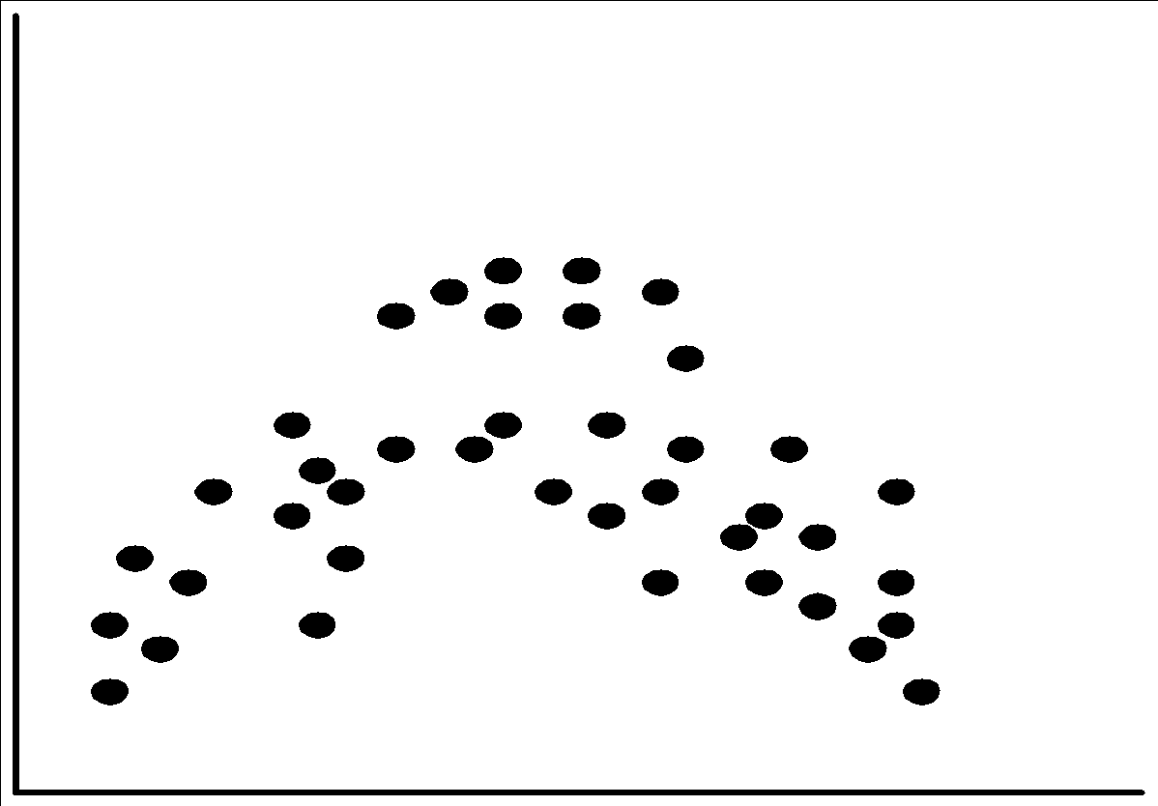
Positively and Negatively Correlated Data
The left half fragment is positively correlated
The right half is negative correlated

Slide 12
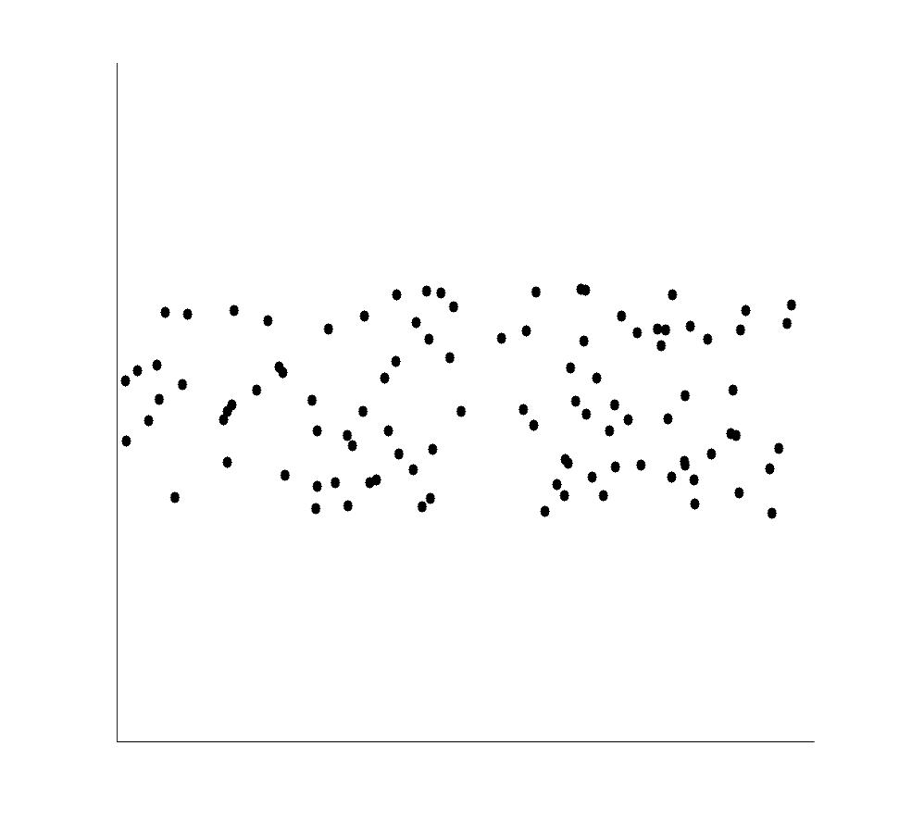
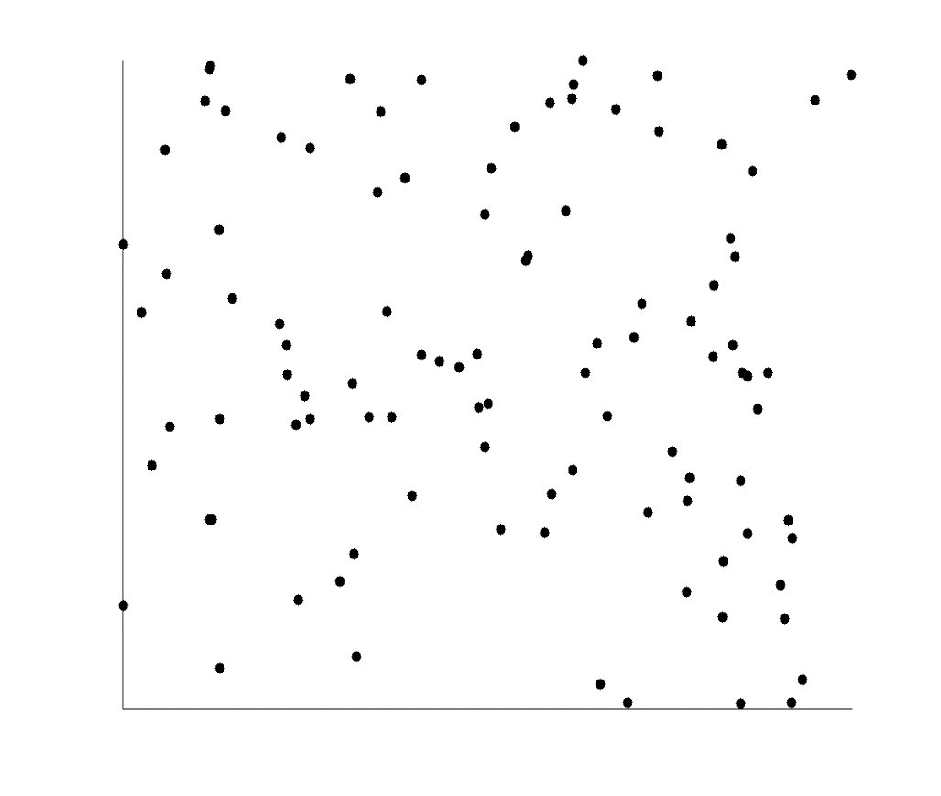
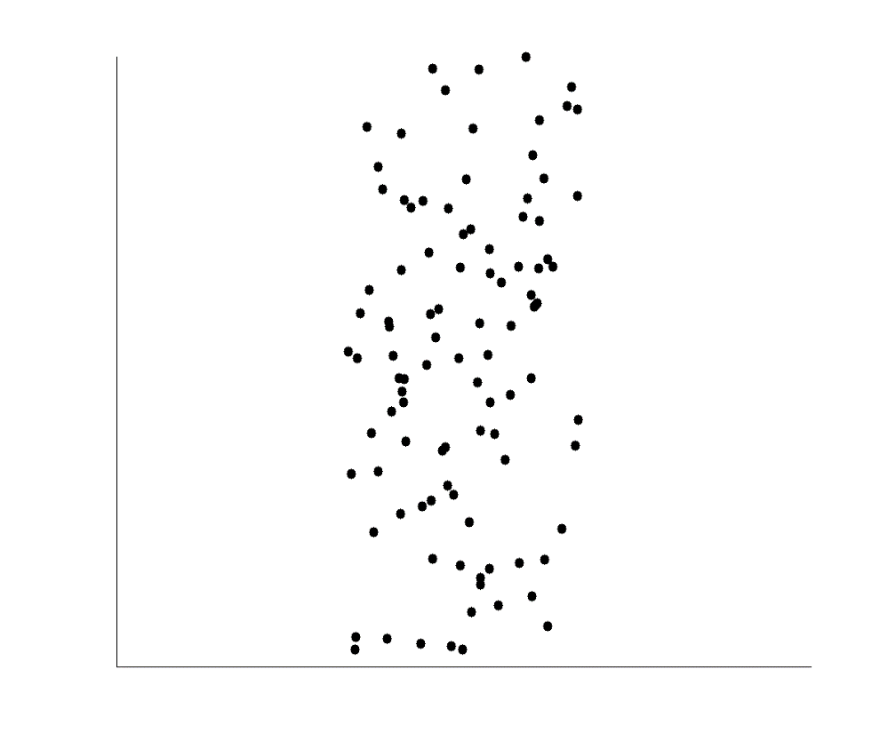
Uncorrelated Data

Slide 13
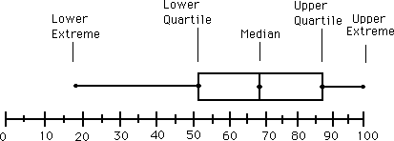
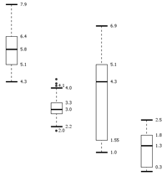
Boxplot Analysis
Five-number summary of a distribution
Minimum, Q1, Median, Q3, Maximum
Boxplot
Data is represented with a box
The ends of the box are at the first and third quartiles, i.e., the height of the box is IQR
The median is marked by a line within the box
Whiskers: two lines outside the box extended to Minimum and Maximum

